Slide 1
Data Structures and Algorithms (11)
CS F211

Slide 2
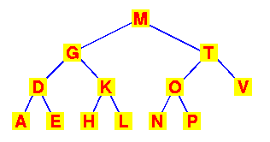
Trees - Searching
Binary search tree
  Produces a sorted list by in-order traversal
In order: A D E G H K L M N O P T V

Slide 3
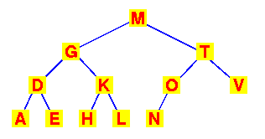
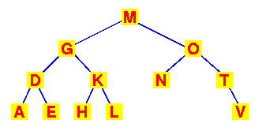
Trees - Searching
Binary search tree
  Preserving the order
  Observe that this transformation preserves the
  search tree

Slide 4
Trees - Searching
Binary search tree
  Preserving the order
  Observe that this transformation preserves the
  search tree
We’ve performed a rotation of the sub-tree
about the T and O nodes

Slide 5
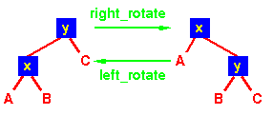
Trees - Rotations
Binary search tree
  Rotations can be either left- or right-rotations
  For both trees: the inorder traversal is
        A x B y C

Slide 6
Trees - Rotations
Binary search tree
  Rotations can be either left- or right-rotations
  For both trees: the inorder traversal is
        A x B y C

Slide 7
Trees - Rotations
Binary search tree
  Rotations can be either left- or right-rotations
  For both trees: the inorder traversal is
        A x B y C

Slide 8
Trees - Rotations
Binary search tree
  Rotations can be either left- or right-rotations
  For both trees: the inorder traversal is
        A x B y C

Slide 9
Trees - Rotations
Binary search tree
  Rotations can be either left- or right-rotations
  Note that in this rotation, it was necessary to move
  B from the right child of x to the left child of y

Slide 10
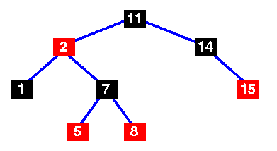
Trees - Red-Black Trees
A Red-Black Tree
  Binary search tree
  Each node is “coloured” red or black
  An ordinary binary search tree with node colourings
  to make a red-black tree

Slide 11
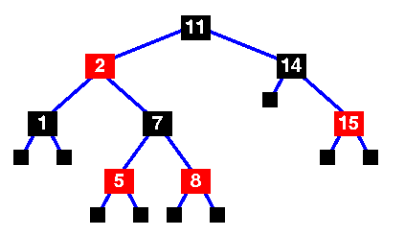
Trees - Red-Black Trees
A Red-Black Tree
  Every node is RED or BLACK
  Every leaf is BLACK
When you examine
rb-tree code, you will
see sentinel nodes (black)
added as the leaves.
They contain no data.
Sentinel nodes (black)

Slide 12
Trees - Red-Black Trees
A Red-Black Tree
  Every node is RED or BLACK
  Every leaf is BLACK
  If a node is RED,
  then both children
  are BLACK
This implies that no path
may have two adjacent
RED nodes.
(But any number of BLACK
nodes may be adjacent.)

Slide 13
Trees - Red-Black Trees
A Red-Black Tree
  Every node is RED or BLACK
  Every leaf is BLACK
  If a node is RED,
  then both children
  are BLACK
  Every path
  from a node to a leaf
  contains the same number
  of BLACK nodes
From the root,
there are 3 BLACK nodes
on every path

Slide 14
Trees - Red-Black Trees
A Red-Black Tree
  Every node is RED or BLACK
  Every leaf is BLACK
  If a node is RED,
  then both children
  are BLACK
  Every path
  from a node to a leaf
  contains the same number
  of BLACK nodes
The length of this path is the
black height of the tree

Slide 15
Height of a Red-black Tree
Example:
Height of a node:
  h(x) = # of edges in a longest path to a leaf.
Black-height of a node
bh(x) = # of black nodes on path from x to leaf, not counting x.
How are they related?
  bh(x) ≤ h(x) ≤ 2 bh(x)

Slide 16
Bound on RB Tree Height
Lemma: The subtree rooted at any node x has
≥ 2^{bh(x)}–1 internal nodes.
Proof: By induction on height of x.
  Base Case: Height h(x) = 0 ⇒ x is a leaf ⇒ bh(x) = 0.
  Subtree has 2⁰–1 = 0 nodes. √
  Induction Step: Height h(x) = h > 0 and bh(x) = b.
    Each child of x has height h - 1 and
    black-height either b (child is red) or b - 1 (child is black).
    By ind. hyp., each child has ≥ 2^{bh(x)– 1}–1 internal nodes.
    Subtree rooted at x has ≥ 2 (2^{bh(x) – 1} – 1)+1
    = 2^{bh(x)} – 1 internal nodes. (The +1 is for x itself.)

Slide 17
Bound on RB Tree Height
Lemma: The subtree rooted at any node x has
≥ 2^{bh(x)}–1 internal nodes.
Lemma: A red-black tree with n internal nodes has height at most 2 lg(n+1).
Proof:
  By the above lemma, n ≥ 2^{bh} – 1,
  and since bh ≥h/2, we have n ≥ 2^{h/2} – 1.
  ⇒ h ≤ 2 lg(n + 1).

Slide 18
Trees - Red-Black Trees
Data structure
  As we’ll see, nodes in red-black trees need to know their parents,
  so we need this data structure
struct t_red_black_node {
enum { red, black } colour;
void *item;
struct t_red_black_node *left,
*right,
*parent;
}
Same as a
binary tree
with these two
attributes
added

Slide 19
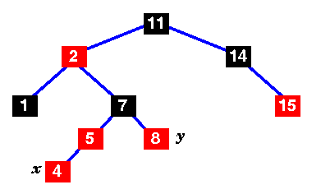
Trees - Insertion
Insertion of a new node
  Requires a re-balance of the tree
rb_insert( Tree T, node x ) {
/* Insert in the tree in the usual way */
tree_insert( T, x );
/* Now restore the red-black property */
x->colour = red;
while ( (x != T->root) && (x->parent->colour == red) ) {
if ( x->parent == x->parent->parent->left ) {
/* If x's parent is a left, y is x's right 'uncle' */
y = x->parent->parent->right;
if ( y->colour == red ) {
/* case 1 - change the colours */
x->parent->colour = black;
y->colour = black;
x->parent->parent->colour = red;
/* Move x up the tree */
x = x->parent->parent;
Insert node
4
Mark it red
Label the current node
x

Slide 20
Trees - Insertion
rb_insert( Tree T, node x ) {
/* Insert in the tree in the usual way */
tree_insert( T, x );
/* Now restore the red-black property */
x->colour = red;
while ( (x != T->root) && (x->parent->colour == red) ) {
if ( x->parent == x->parent->parent->left ) {
/* If x's parent is a left, y is x's right 'uncle' */
y = x->parent->parent->right;
if ( y->colour == red ) {
/* case 1 - change the colours */
x->parent->colour = black;
y->colour = black;
x->parent->parent->colour = red;
/* Move x up the tree */
x = x->parent->parent;
While we haven’t reached the root
and x’s parent is red
x->parent

Slide 21
Trees - Insertion
rb_insert( Tree T, node x ) {
/* Insert in the tree in the usual way */
tree_insert( T, x );
/* Now restore the red-black property */
x->colour = red;
while ( (x != T->root) && (x->parent->colour == red) ) {
if ( x->parent == x->parent->parent->left ) {
/* If x's parent is a left, y is x's right 'uncle' */
y = x->parent->parent->right;
if ( y->colour == red ) {
/* case 1 - change the colours */
x->parent->colour = black;
y->colour = black;
x->parent->parent->colour = red;
/* Move x up the tree */
x = x->parent->parent;
If x is to the left of it’s granparent
x->parent->parent
x->parent

Slide 22
Trees - Insertion
/* Now restore the red-black property */
x->colour = red;
while ( (x != T->root) && (x->parent->colour == red) ) {
if ( x->parent == x->parent->parent->left ) {
/* If x's parent is a left, y is x's right 'uncle' */
y = x->parent->parent->right;
if ( y->colour == red ) {
/* case 1 - change the colours */
x->parent->colour = black;
y->colour = black;
x->parent->parent->colour = red;
/* Move x up the tree */
x = x->parent->parent;
y is x’s right uncle
x->parent->parent
x->parent
right “uncle”

Slide 23
Trees - Insertion
while ( (x != T->root) && (x->parent->colour == red) ) {
if ( x->parent == x->parent->parent->left ) {
/* If x's parent is a left, y is x's right 'uncle' */
y = x->parent->parent->right;
if ( y->colour == red ) {
/* case 1 - change the colours */
x->parent->colour = black;
y->colour = black;
x->parent->parent->colour = red;
/* Move x up the tree */
x = x->parent->parent;
If the uncle is red, change
the colours of y, the grand-parent
and the parent
x->parent->parent
x->parent
right “uncle”

Slide 24
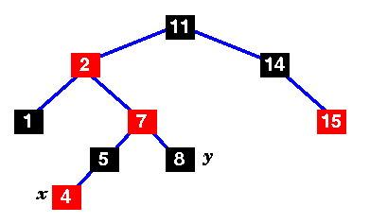
Trees - Insertion
while ( (x != T->root) && (x->parent->colour == red) ) {
if ( x->parent == x->parent->parent->left ) {
/* If x's parent is a left, y is x's right 'uncle' */
y = x->parent->parent->right;
if ( y->colour == red ) {
/* case 1 - change the colours */
x->parent->colour = black;
y->colour = black;
x->parent->parent->colour = red;
/* Move x up the tree */
x = x->parent->parent;

Slide 25

Trees - Insertion
while ( (x != T->root) && (x->parent->colour == red) ) {
if ( x->parent == x->parent->parent->left ) {
/* If x's parent is a left, y is x's right 'uncle' */
y = x->parent->parent->right;
if ( y->colour == red ) {
/* case 1 - change the colours */
x->parent->colour = black;
y->colour = black;
x->parent->parent->colour = red;
/* Move x up the tree */
x = x->parent->parent;
x’s parent is a left again,
mark x’s uncle
but the uncle is black this time
New x

Slide 26
Trees - Insertion
while ( (x != T->root) && (x->parent->colour == red) ) {
if ( x->parent == x->parent->parent->left ) {
/* If x's parent is a left, y is x's right 'uncle' */
y = x->parent->parent->right;
if ( y->colour == red ) {
/* case 1 - change the colours */
x->parent->colour = black;
y->colour = black;
x->parent->parent->colour = red;
/* Move x up the tree */
x = x->parent->parent;
else {
/* y is a black node */
if ( x == x->parent->right ) {
/* and x is to the right */
/* case 2 - move x up and rotate */
x = x->parent;
left_rotate( T, x );
.. but the uncle is black this time
and x is to the right of it’s parent

Slide 27
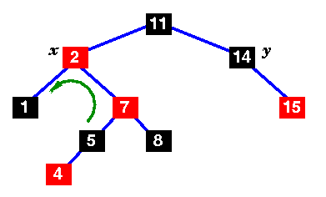
Trees - Insertion
while ( (x != T->root) && (x->parent->colour == red) ) {
if ( x->parent == x->parent->parent->left ) {
/* If x's parent is a left, y is x's right 'uncle' */
y = x->parent->parent->right;
if ( y->colour == red ) {
/* case 1 - change the colours */
x->parent->colour = black;
y->colour = black;
x->parent->parent->colour = red;
/* Move x up the tree */
x = x->parent->parent;
else {
/* y is a black node */
if ( x == x->parent->right ) {
/* and x is to the right */
/* case 2 - move x up and rotate */
x = x->parent;
left_rotate( T, x );
.. So move x up and
rotate about x as root ...

Slide 28
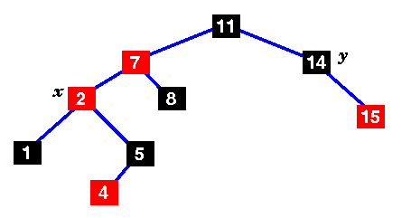
Trees - Insertion
while ( (x != T->root) && (x->parent->colour == red) ) {
if ( x->parent == x->parent->parent->left ) {
/* If x's parent is a left, y is x's right 'uncle' */
y = x->parent->parent->right;
if ( y->colour == red ) {
/* case 1 - change the colours */
x->parent->colour = black;
y->colour = black;
x->parent->parent->colour = red;
/* Move x up the tree */
x = x->parent->parent;
else {
/* y is a black node */
if ( x == x->parent->right ) {
/* and x is to the right */
/* case 2 - move x up and rotate */
x = x->parent;
left_rotate( T, x );

Slide 29
Trees - Insertion
while ( (x != T->root) && (x->parent->colour == red) ) {
if ( x->parent == x->parent->parent->left ) {
/* If x's parent is a left, y is x's right 'uncle' */
y = x->parent->parent->right;
if ( y->colour == red ) {
/* case 1 - change the colours */
x->parent->colour = black;
y->colour = black;
x->parent->parent->colour = red;
/* Move x up the tree */
x = x->parent->parent;
else {
/* y is a black node */
if ( x == x->parent->right ) {
/* and x is to the right */
/* case 2 - move x up and rotate */
x = x->parent;
left_rotate( T, x );
.. but x’s parent is still red ...

Slide 30
Trees - Insertion
while ( (x != T->root) && (x->parent->colour == red) ) {
if ( x->parent == x->parent->parent->left ) {
/* If x's parent is a left, y is x's right 'uncle' */
y = x->parent->parent->right;
if ( y->colour == red ) {
/* case 1 - change the colours */
x->parent->colour = black;
y->colour = black;
x->parent->parent->colour = red;
/* Move x up the tree */
x = x->parent->parent;
else {
/* y is a black node */
if ( x == x->parent->right ) {
/* and x is to the right */
/* case 2 - move x up and rotate */
x = x->parent;
left_rotate( T, x );
.. The uncle is black ..
uncle
.. and x is to the left of its parent

Slide 31
Trees - Insertion
while ( (x != T->root) && (x->parent->colour == red) ) {
if ( x->parent == x->parent->parent->left ) {
/* If x's parent is a left, y is x's right 'uncle' */
y = x->parent->parent->right;
if ( y->colour == red ) {
/* case 1 - change the colours */
x->parent->colour = black;
y->colour = black;
x->parent->parent->colour = red;
/* Move x up the tree */
x = x->parent->parent;
else {
/* y is a black node */
if ( x == x->parent->right ) {
/* and x is to the right */
/* case 2 - move x up and rotate */
x = x->parent;
left_rotate( T, x );
else { /* case 3 */
x->parent->colour = black;
x->parent->parent->colour = red;
right_rotate( T, x->parent->parent );
}
.. So we have the final case ..

Slide 32
Trees - Insertion
while ( (x != T->root) && (x->parent->colour == red) ) {
if ( x->parent == x->parent->parent->left ) {
/* If x's parent is a left, y is x's right 'uncle' */
y = x->parent->parent->right;
if ( y->colour == red ) {
/* case 1 - change the colours */
x->parent->colour = black;
y->colour = black;
x->parent->parent->colour = red;
/* Move x up the tree */
x = x->parent->parent;
else {
/* y is a black node */
if ( x == x->parent->right ) {
/* and x is to the right */
/* case 2 - move x up and rotate */
x = x->parent;
left_rotate( T, x );
else { /* case 3 */
x->parent->colour = black;
x->parent->parent->colour = red;
right_rotate( T, x->parent->parent );
}
.. Change colours
and rotate ..

Slide 33
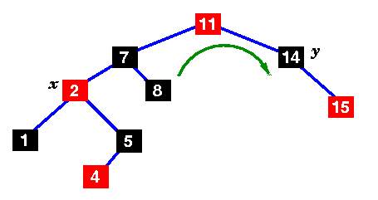
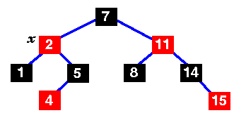
Trees - Insertion
while ( (x != T->root) && (x->parent->colour == red) ) {
if ( x->parent == x->parent->parent->left ) {
/* If x's parent is a left, y is x's right 'uncle' */
y = x->parent->parent->right;
if ( y->colour == red ) {
/* case 1 - change the colours */
x->parent->colour = black;
y->colour = black;
x->parent->parent->colour = red;
/* Move x up the tree */
x = x->parent->parent;
else {
/* y is a black node */
if ( x == x->parent->right ) {
/* and x is to the right */
/* case 2 - move x up and rotate */
x = x->parent;
left_rotate( T, x );
else { /* case 3 */
x->parent->colour = black;
x->parent->parent->colour = red;
right_rotate( T, x->parent->parent );
}

Slide 34
Trees - Insertion
while ( (x != T->root) && (x->parent->colour == red) ) {
if ( x->parent == x->parent->parent->left ) {
/* If x's parent is a left, y is x's right 'uncle' */
y = x->parent->parent->right;
if ( y->colour == red ) {
/* case 1 - change the colours */
x->parent->colour = black;
y->colour = black;
x->parent->parent->colour = red;
/* Move x up the tree */
x = x->parent->parent;
else {
/* y is a black node */
if ( x == x->parent->right ) {
/* and x is to the right */
/* case 2 - move x up and rotate */
x = x->parent;
left_rotate( T, x );
else { /* case 3 */
x->parent->colour = black;
x->parent->parent->colour = red;
right_rotate( T, x->parent->parent );
}
This is now a red-black tree ..
So we’re finished!

Slide 35
Trees - Insertion
while ( (x != T->root) && (x->parent->colour == red) ) {
if ( x->parent == x->parent->parent->left ) {
/* If x's parent is a left, y is x's right 'uncle' */
y = x->parent->parent->right;
if ( y->colour == red ) {
/* case 1 - change the colours */
x->parent->colour = black;
y->colour = black;
x->parent->parent->colour = red;
/* Move x up the tree */
x = x->parent->parent;
else {
/* y is a black node */
if ( x == x->parent->right ) {
/* and x is to the right */
/* case 2 - move x up and rotate */
x = x->parent;
left_rotate( T, x );
else { /* case 3 */
x->parent->colour = black;
x->parent->parent->colour = red;
right_rotate( T, x->parent->parent );
}
}
else ....
There’s an equivalent set of
cases when the parent is to
the right of the grandparent!

Slide 36
Red-black trees - Analysis
Addition
  Insertion Comparisons O(log n)
  Fix-up
    At every stage,
    x moves up the tree
    at least one level O(log n)
  Overall O(log n)
Deletion
  Also O(log n)
More complex
... but gives O(log n) behaviour in dynamic cases

Slide 37
Red Black Trees - What you need to know?
You need to know
  The algorithm exists
  What it’s called
  When to use it
    ie what problem does it solve?
  Its complexity
  Basically how it works
  Where to find an implementation
    How to transform it to your application

Slide 38
Thank You!!

